Slide 1
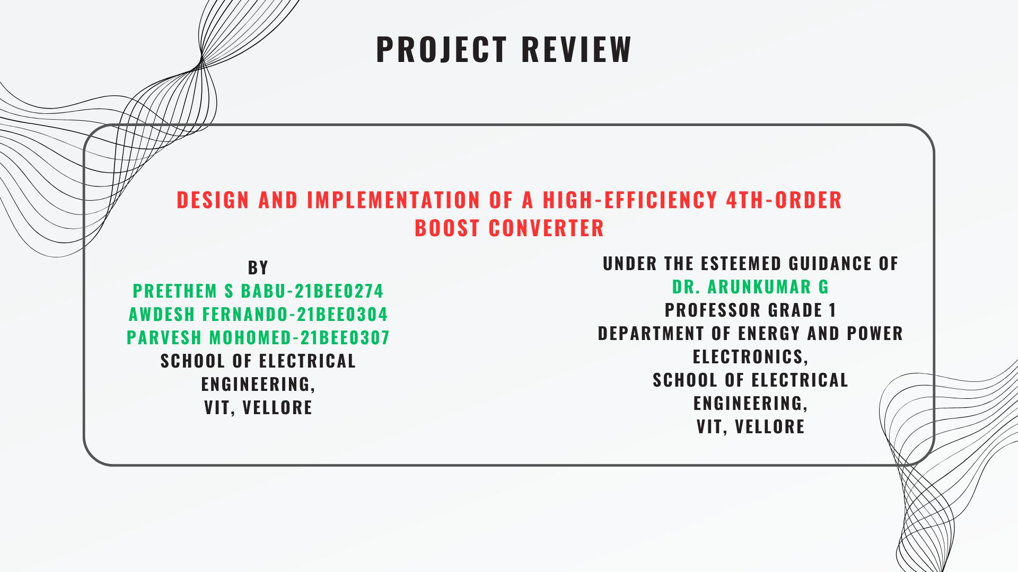
Project Review
Design and Implementation of a High-Efficiency 4th-Order Boost Converter
By
Preethem S Babu-21BEE0274
Awdesh Fernando-21BEE0304
Parvesh Mohomed-21BEE0307
School of Electrical Engineering,
VIT, Vellore
Under the Esteemed Guidance of
Dr. Arunkumar G
Professor Grade 1
Department of Energy and Power Electronics,
School of Electrical Engineering,
VIT, Vellore

Slide 2
Presentation Outline
Motivation
Need for Project
Literature Review
Research Gap
Research Objectives
Proposed Converter
Analysis and Design
Time Line

Slide 3
Suitable for general-purpose applications, such as LED drivers, portable electronics, or where moderate step-up and efficiency are sufficient.
Motivation
Need for Project
Literature Review
Research Gap
Research Objectives
Proposed Converter
Analysis and Design
Problems with conventional converters:
Limited to moderate voltage gain- Achieving higher gains requires a high duty cycle, which can lead to efficiency losses and stress on components.
Efficiency - When operating at high duty cycles, efficiency can decrease due to factors such as switching losses, conduction losses, and increased ripple
Input and Output Ripple - Input and output current and voltage ripple can be high, especially under heavy load. This can create EMI and noise, which may interfere with sensitive circuits.
Dynamic Response and Stability - It can be sensitive to sudden load changes due to a lack of additional reactive components that could help dampen fluctuations. Stability may also become an issue at high gains or in high-power applications.

Slide 4
Motivation
Need for Project
Literature Review
Research Gap
Research Objectives
Proposed Converter
Analysis and Design
Need for the Proposed Converter
Voltage gains: Can achieve significantly higher voltage gains without extreme duty cycles.
Reduced Output Voltage Ripple: The additional LC filter smoothen the output voltage, producing a cleaner DC supply.
Stability: Better dynamic response and stability due to the additional filtering stages, which can better handle load and line transients.
Efficiency: Typically more efficient, as it achieves high voltage gains at lower duty cycles. The additional components help manage ripple and current, reducing losses and improving overall efficiency.

Slide 5
Motivation
Need for Project
Literature Review
Research Gap
Research Objectives
Proposed Converter
Analysis and Design
Literature Review
No | Title | Topology | Components | Observations
1 | The Fourth-Order Single-Switch Improved Super-Boost Converter with Reduced Input Current Ripple Enrique Garza-Arias 1, Julio C. Rosas-Caro 2,* , Jesus E. Valdez-Resendiz 1,* Enrique Garza-Arias 1, Julio C. | Super-Boost Converter | 1 Mosfet, 1 diode, 2 inductor, 2 capacitor Load Resistor | The fourth-order super boost converter reduces input current ripple, achieves high voltage gain, and improves output stability with minimal ripple.
2 | Non-Isolated Fourth-Order Boost DC-DC Converter for Power Management in Low Voltage Low Power DC Grids: Design and Interaction Analysis Ashima kulshreshth a 1, Anmolratnasaxena1, (senior member, ieee), and Mummadiveerachary2 | Non-Isolated fourth-order boost converter | 2 Mosfet, 1 diode, 2 inductor, 2 capacitor Digital Controller | The study proposes a fourth-order boost converter designed to improve power management in low voltage, low power DC grids. This converter achieves continuous input and output currents, reducing ripple effects compared to traditional boost converters.

Slide 6
Motivation
Need for Project
Literature Review
Research Gap
Research Objectives
Proposed Converter
Analysis and Design
Ref. | Title | Topology | Components | Observations
3 | The Fourth-Order Single-Switch Improved Super-Boost Converter with Reduced Input Current Ripple Enrique Garza-Arias 1, Julio C. Rosas-Caro 2,* , Jesus E. Valdez-Resendiz 1,* Gerardo Escobar-Valderrama 1, Daniel Guillen 1 1 andAlmaRodríguez2,4 , Jonathan C. Mayo-Maldonado 3 | Fourth-Order | 1 Mosfet, 1 diode, 2 inductor, 2 capacitor, Load Resistor | The proposed fourth-order single-switch boost converter is an improvement over traditional and super-boost converters. It achieves a significant reduction in input current ripple, thereby enhancing overall efficiency and reducing electromagnetic interference (EMI).
4 | Performance Analysis of Boost Converter by Using Different Integration Algorithms H. Abdelgawad, V. K. Sood | Boost Converter | 1 Mosfet, 1 diode, 1 inductor, 1 capacitor, Load Resistor | This research investigates nine numerical integration methods for simulating DC-DC boost converters in continuous conduction mode (CCM), both with and without parasitic elements. The analysis focuses on the accuracy, stability, and computational efficiency of these algorithms.

Slide 7
Motivation
Need for Project
Literature Review
Research Gap
Research Objectives
Proposed Converter
Analysis and Design
Based on the literature review, the following research gaps were identified:
It is limited to moderate voltage gain, and achieving higher gains requires a high duty cycle, which can lead to efficiency losses and increased stress on components.
Input and output current and voltage ripple can be significant, particularly under heavy loads, which may generate EMI and noise, potentially affecting sensitive circuits.
It can also be sensitive to sudden load changes due to a lack of reactive components to dampen fluctuations.
Efficiency may drop at high duty cycles because of increased switching losses, conduction losses, and ripple.

Slide 8
Motivation
Need for Project
Literature Review
Research Gap
Research Objectives
Proposed Converter
Analysis and Design
Based on the gaps found in the research, the objectives considered for this work are listed below
Achieves significantly higher voltage gains without requiring extreme duty cycles.
Greatly reduced ripple at both the input and output, thanks to additional reactive components.
Improved dynamic response and stability due to extra filtering stages, which allow it to handle load and line transients more effectively.
Generally more efficient, reaching high voltage gains at lower duty cycles. The additional components help control ripple and current, minimizing losses and boosting overall efficiency.

Slide 9
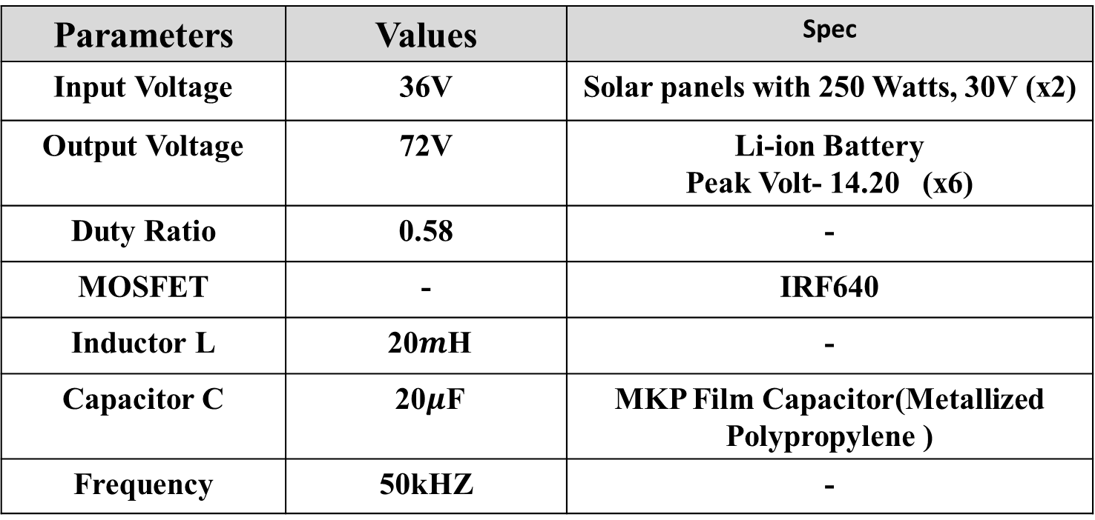
Motivation
Need for Project
Literature Review
Research Gap
Research Objectives
Proposed Converter
Analysis and Design
Design Specification
Parameters | Values | Spec
Input Voltage | 36V | Solar panels with 250 Watts, 30V (x2)
Output Voltage | 72V | Li-ion Battery Peak Volt- 14.20 (x6)
Duty Ratio | 0.58 | -
MOSFET | - | IRF640
Inductor L | 20$m$H | -
Capacitor C | 20$μ$F | MKP Film Capacitor(Metallized Polypropylene )
Frequency | 50kHZ | -

Slide 10
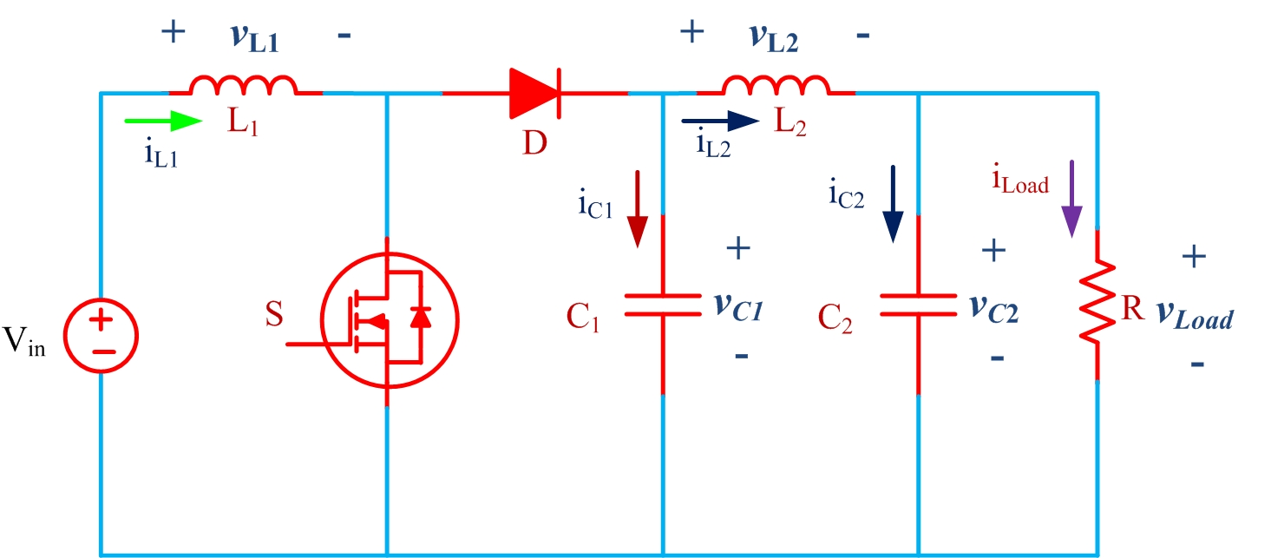
Motivation
Need for Project
Literature Review
Research Gap
Research Objectives
Proposed Converter
Analysis and Design
Proposed Circuit Diagram

Slide 11
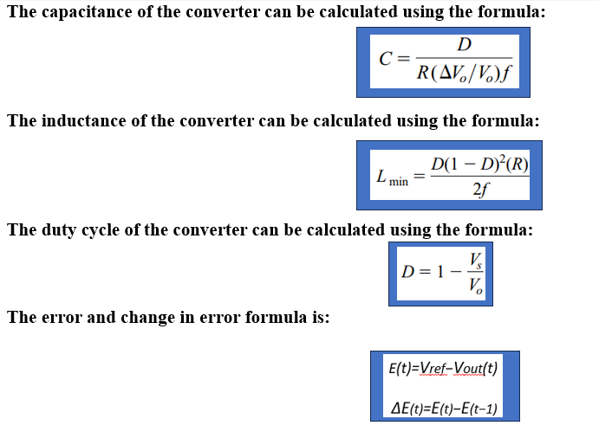
Motivation
Need for Project
Literature Review
Research Gap
Research Objectives
Proposed Converter
Analysis and Design
Design Formula

Slide 12
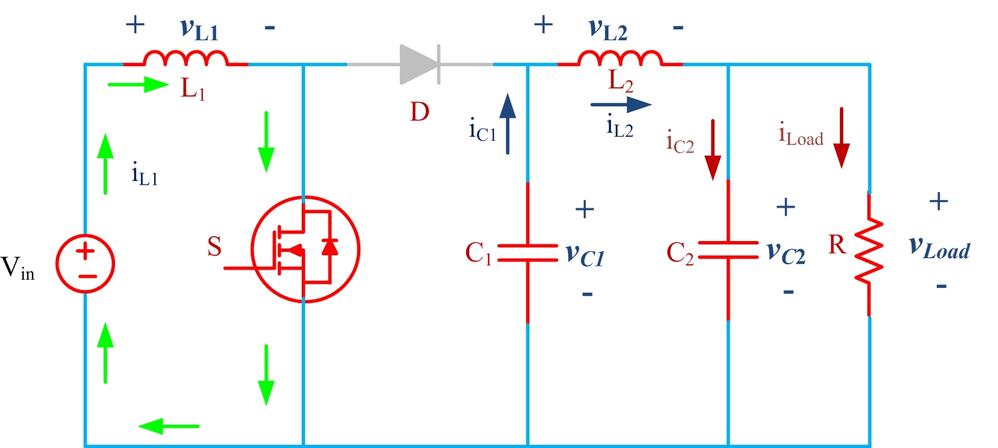
Motivation
Need for Project
Literature Review
Research Gap
Research Objectives
Proposed Converter
Analysis and Design
Modes of Operation
Mode : 1

Slide 13
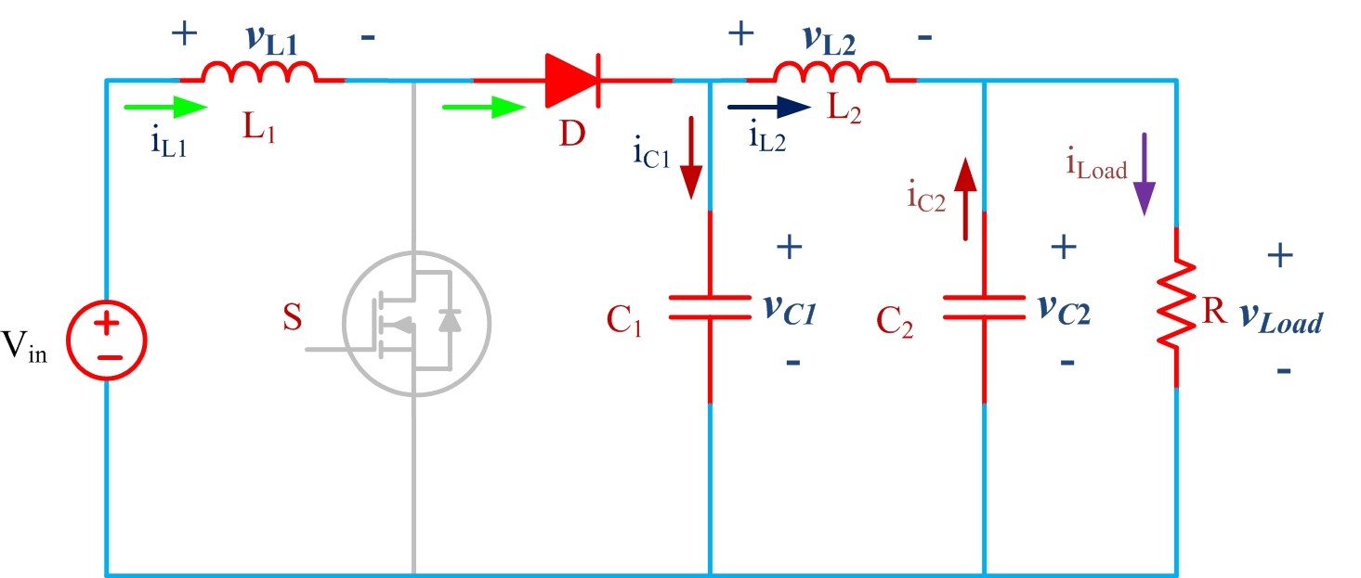
Motivation
Need for Project
Literature Review
Research Gap
Research Objectives
Proposed Converter
Analysis and Design
Modes of Operation
Mode : 2

Slide 14
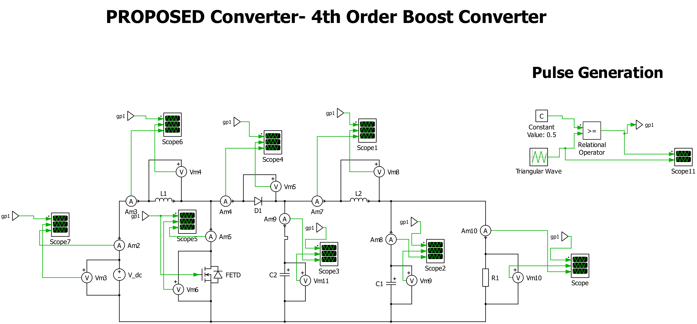
Motivation
Need for Project
Literature Review
Research Gap
Research Objectives
Proposed Converter
Analysis and Design
PLECS Simulation

Slide 15
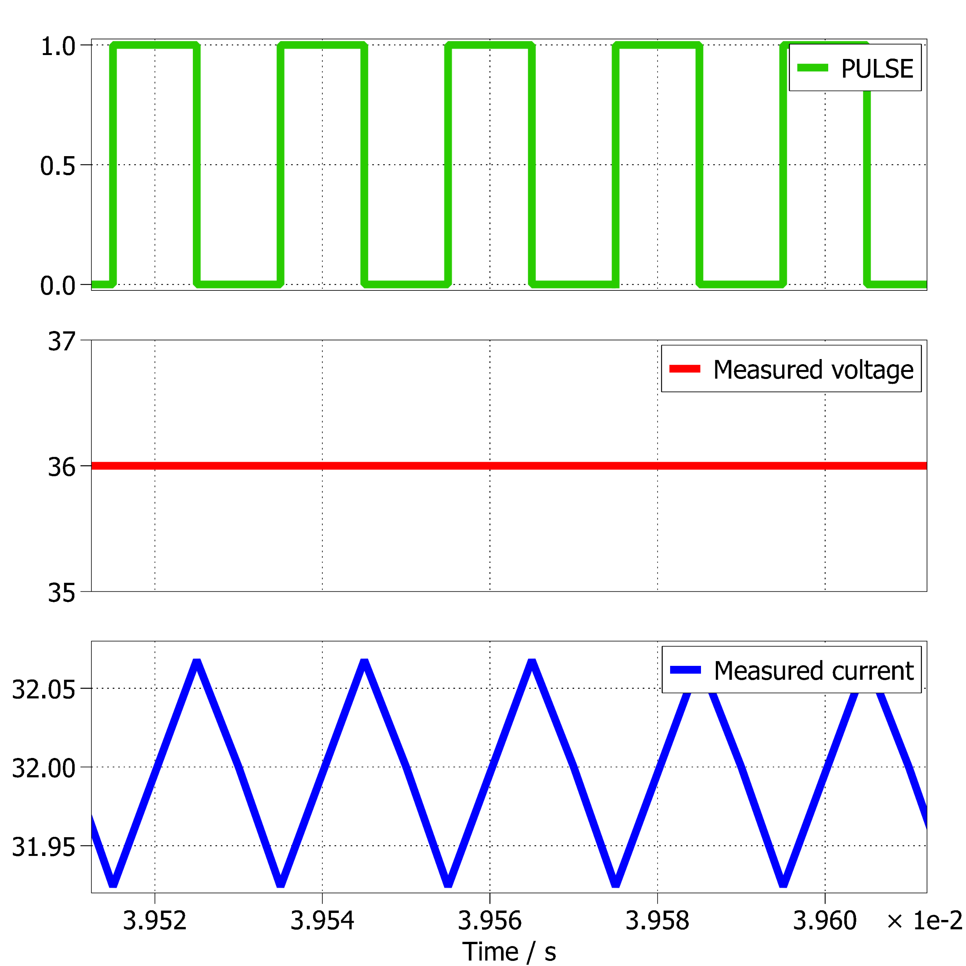
Motivation
Need for Project
Literature Review
Research Gap
Research Objectives
Proposed Converter
Analysis and Design
Simulation Result
Source voltage and current

Slide 16
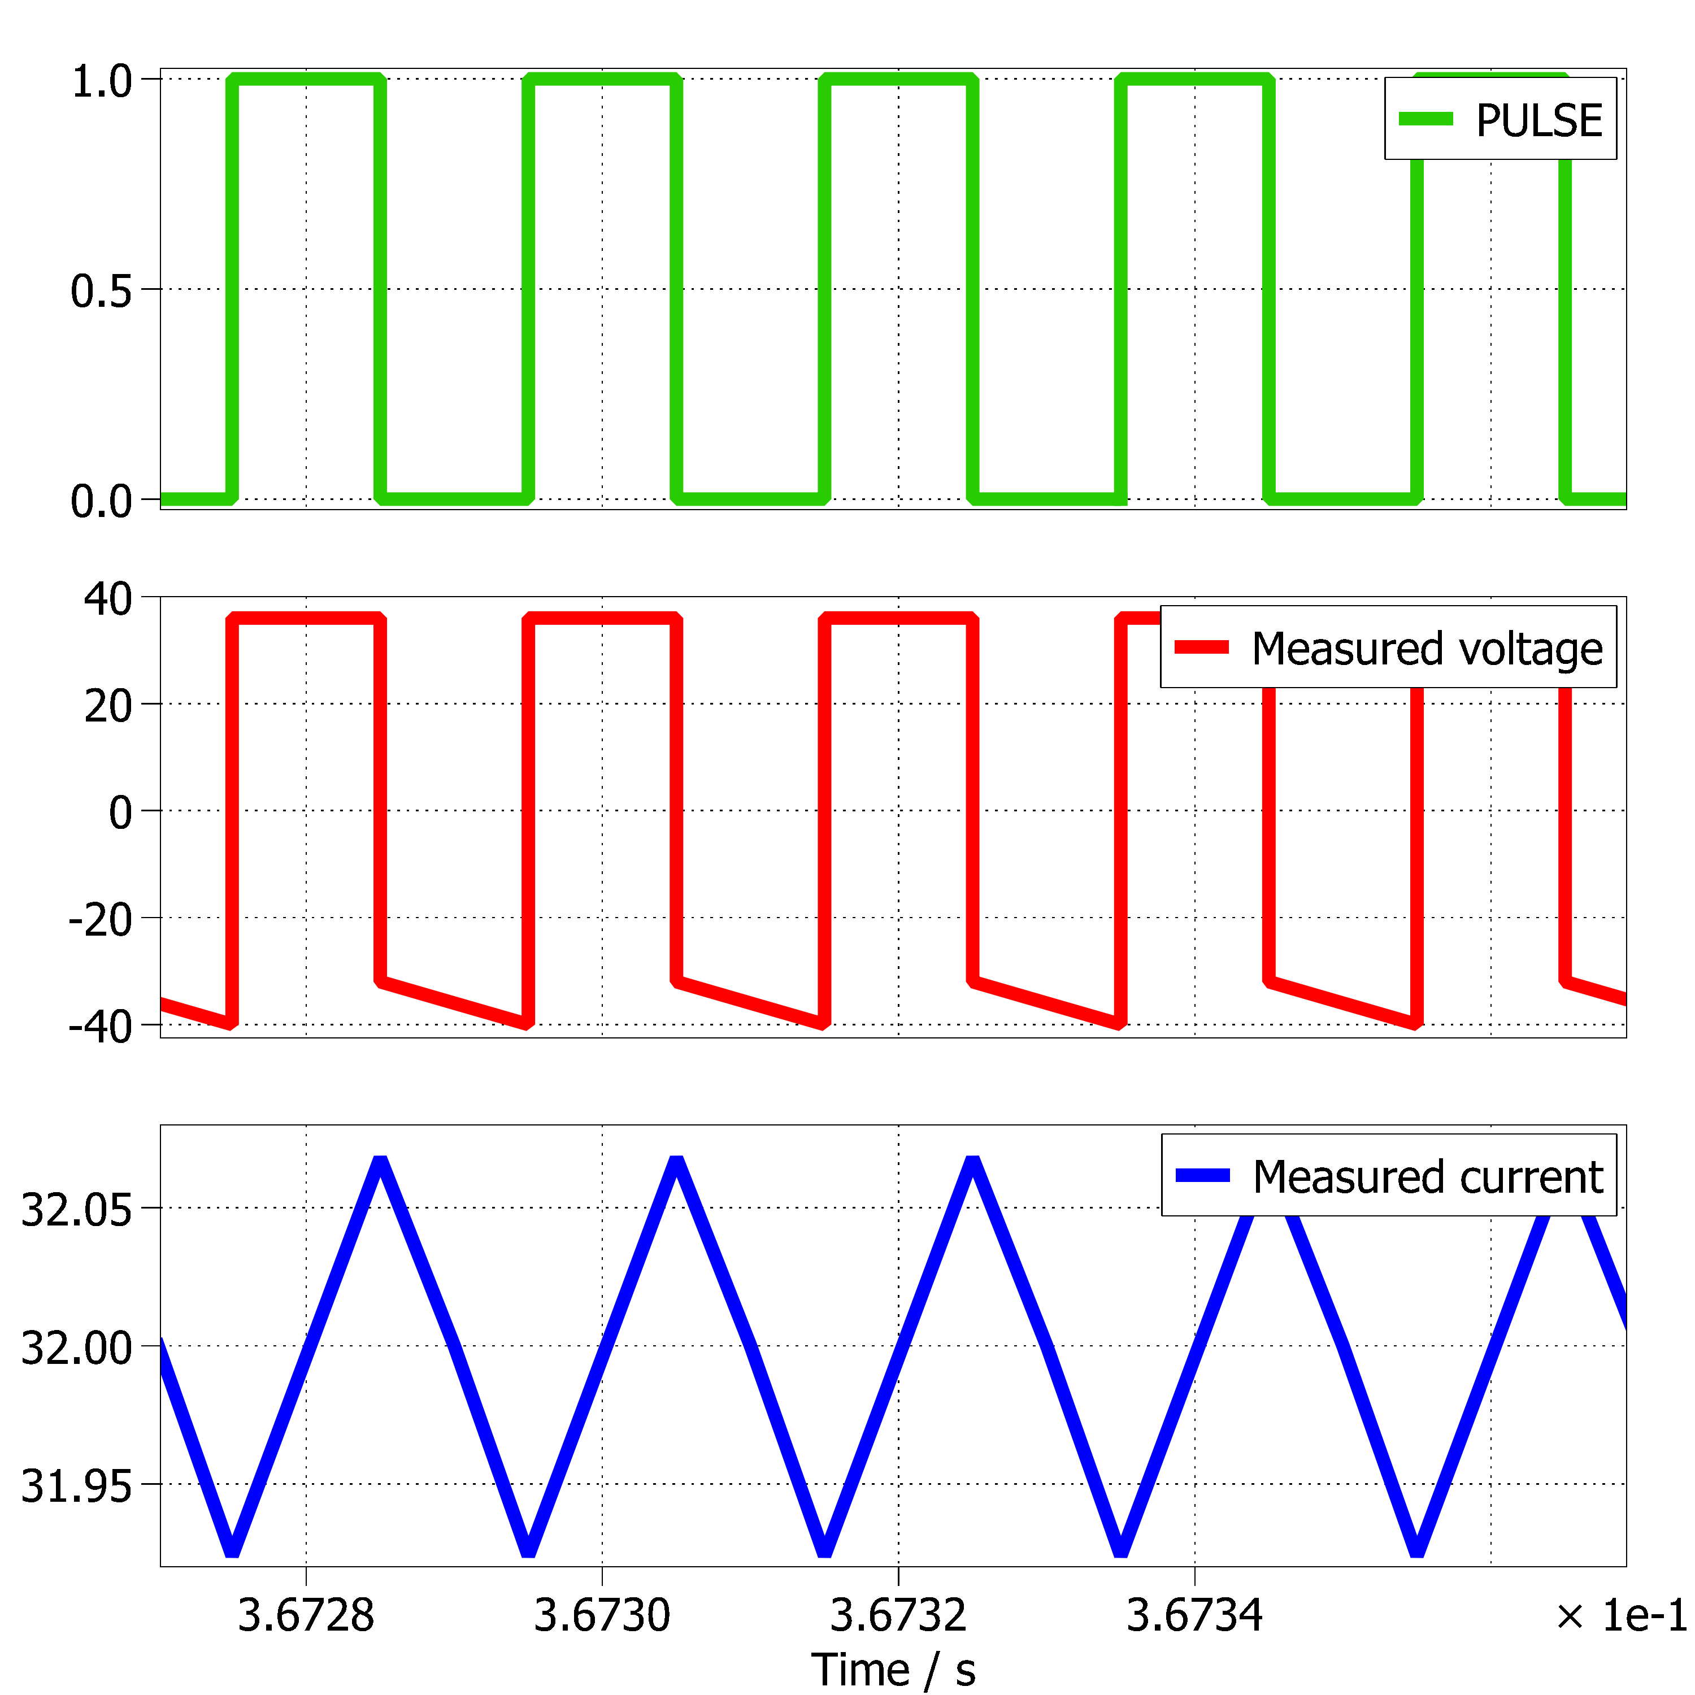
Motivation
Need for Project
Literature Review
Research Gap
Research Objectives
Proposed Converter
Analysis and Design
Simulation Result
voltage and current across Inductor L1

Slide 17
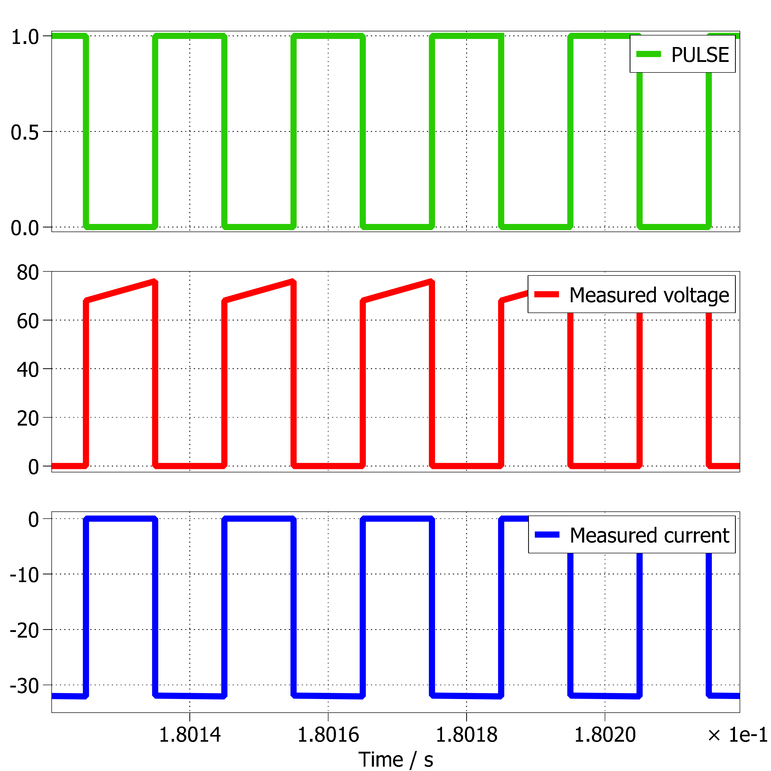
Motivation
Need for Project
Literature Review
Research Gap
Research Objectives
Proposed Converter
Analysis and Design
Simulation Result
voltage and current across Switch

Slide 18
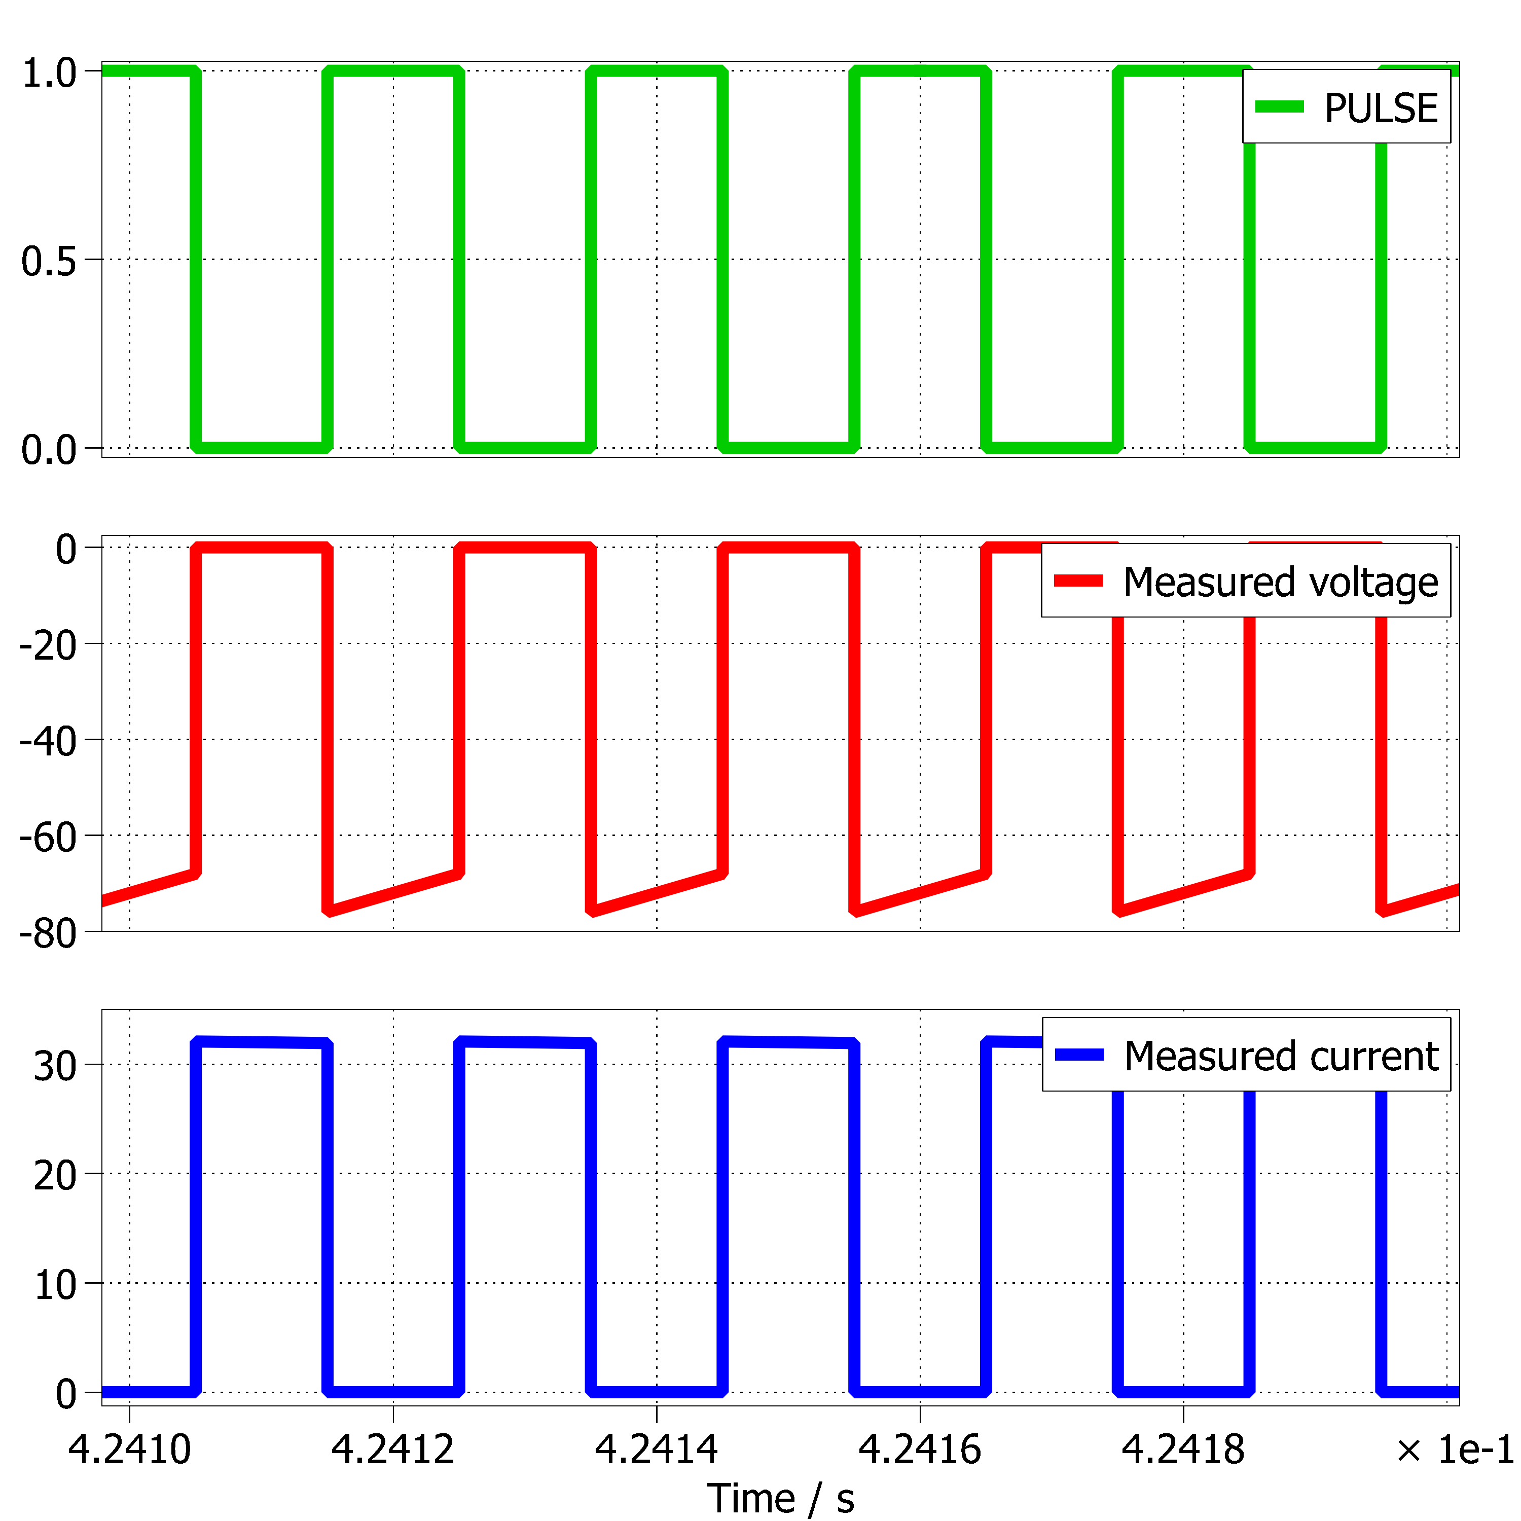
Motivation
Need for Project
Literature Review
Research Gap
Research Objectives
Proposed Converter
Analysis and Design
Simulation Result
voltage and current across Diode

Slide 19
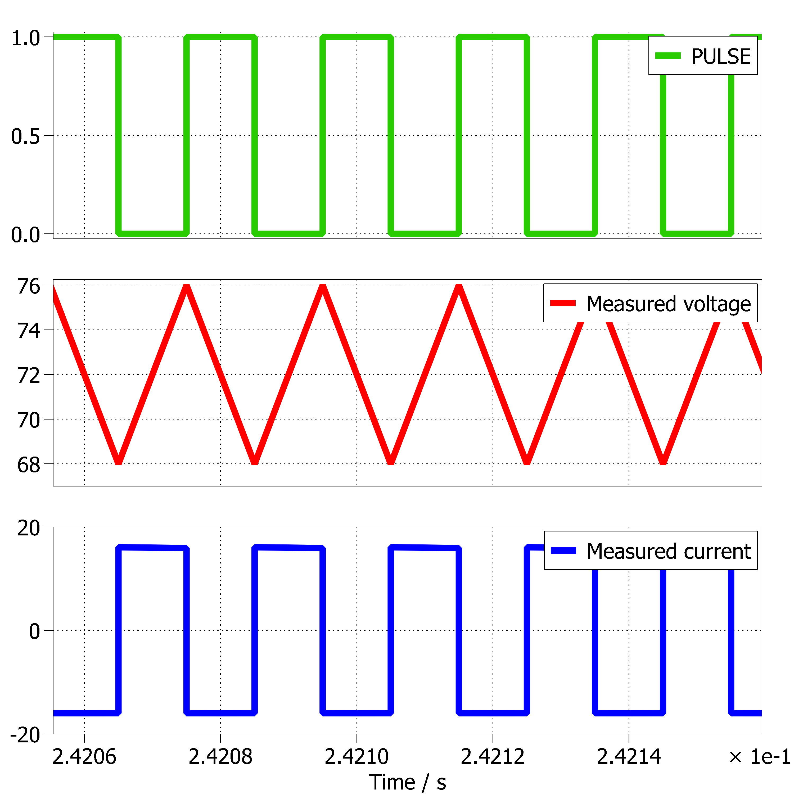
Motivation
Need for Project
Literature Review
Research Gap
Research Objectives
Proposed Converter
Analysis and Design
Simulation Result
voltage and current across Capacitor C1

Slide 20
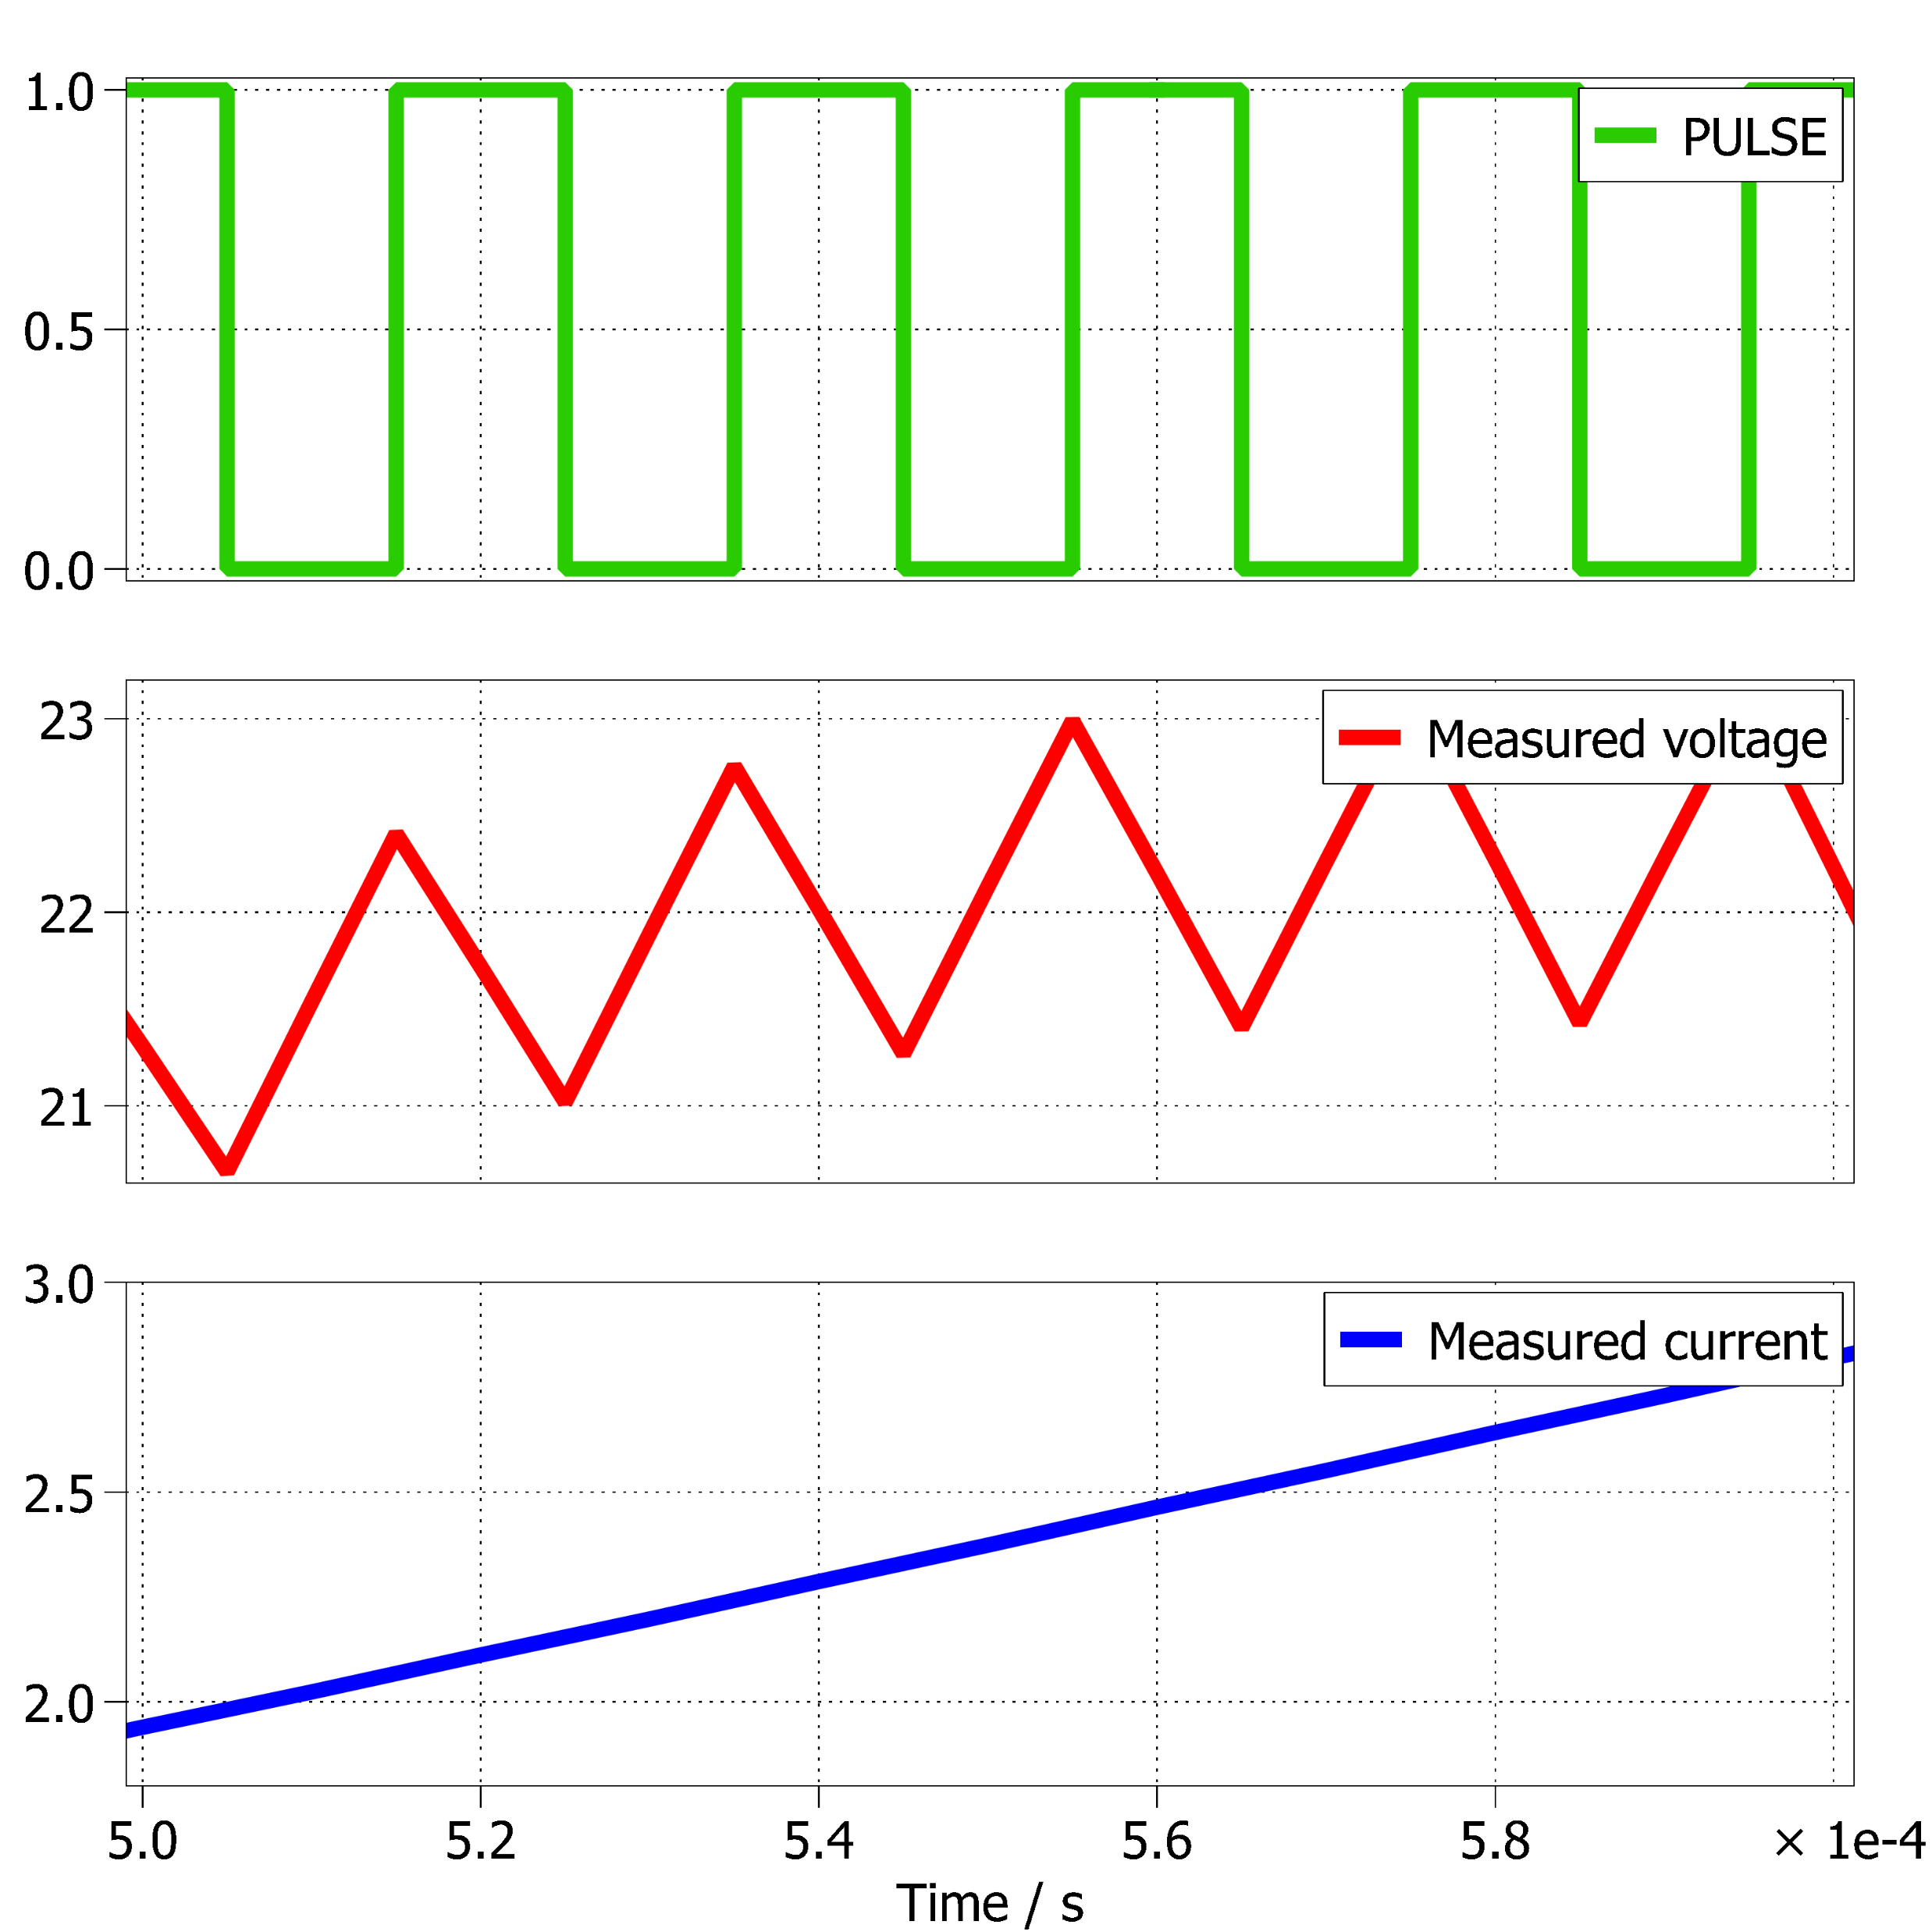
Motivation
Need for Project
Literature Review
Research Gap
Research Objectives
Proposed Converter
Analysis and Design
Simulation Result
voltage and current across Inductor L2

Slide 21
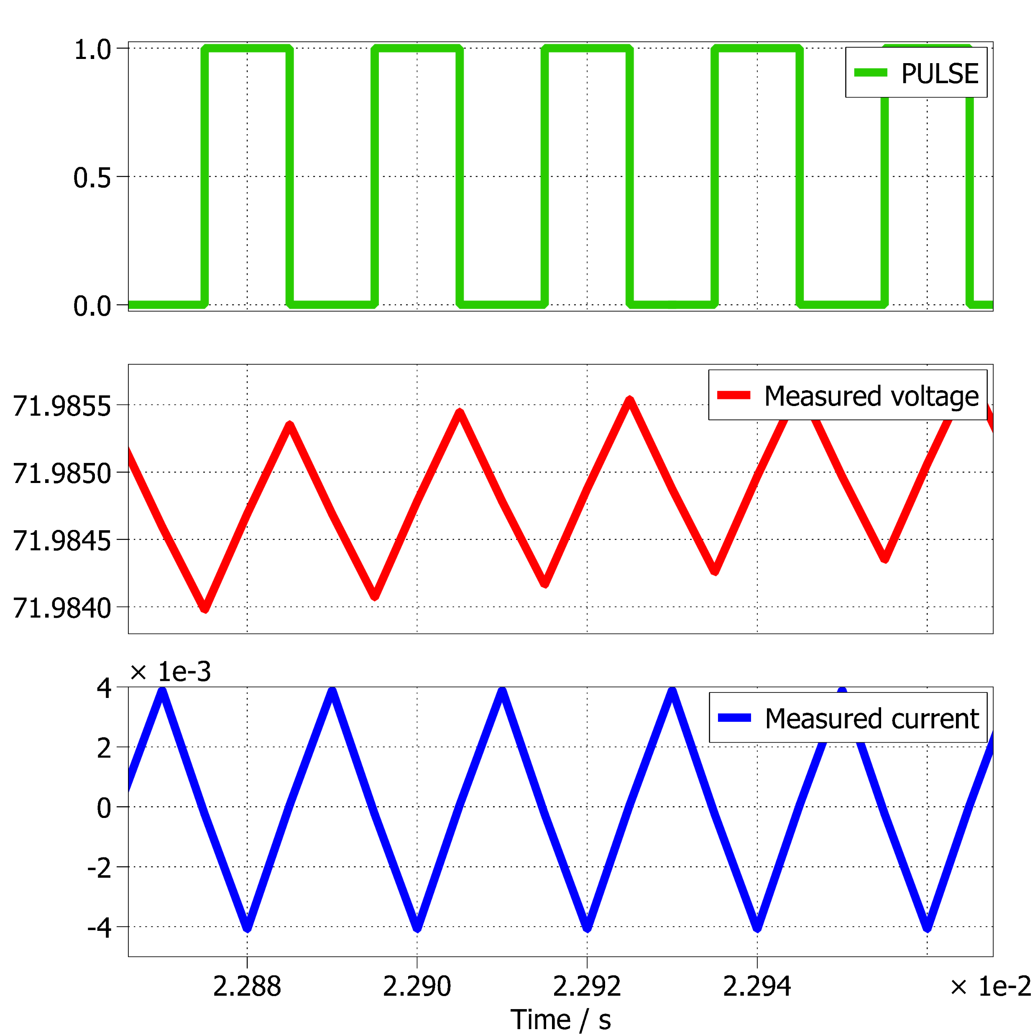
Motivation
Need for Project
Literature Review
Research Gap
Research Objectives
Proposed Converter
Analysis and Design
Simulation Result
voltage and current across Capacitor C2

Slide 22
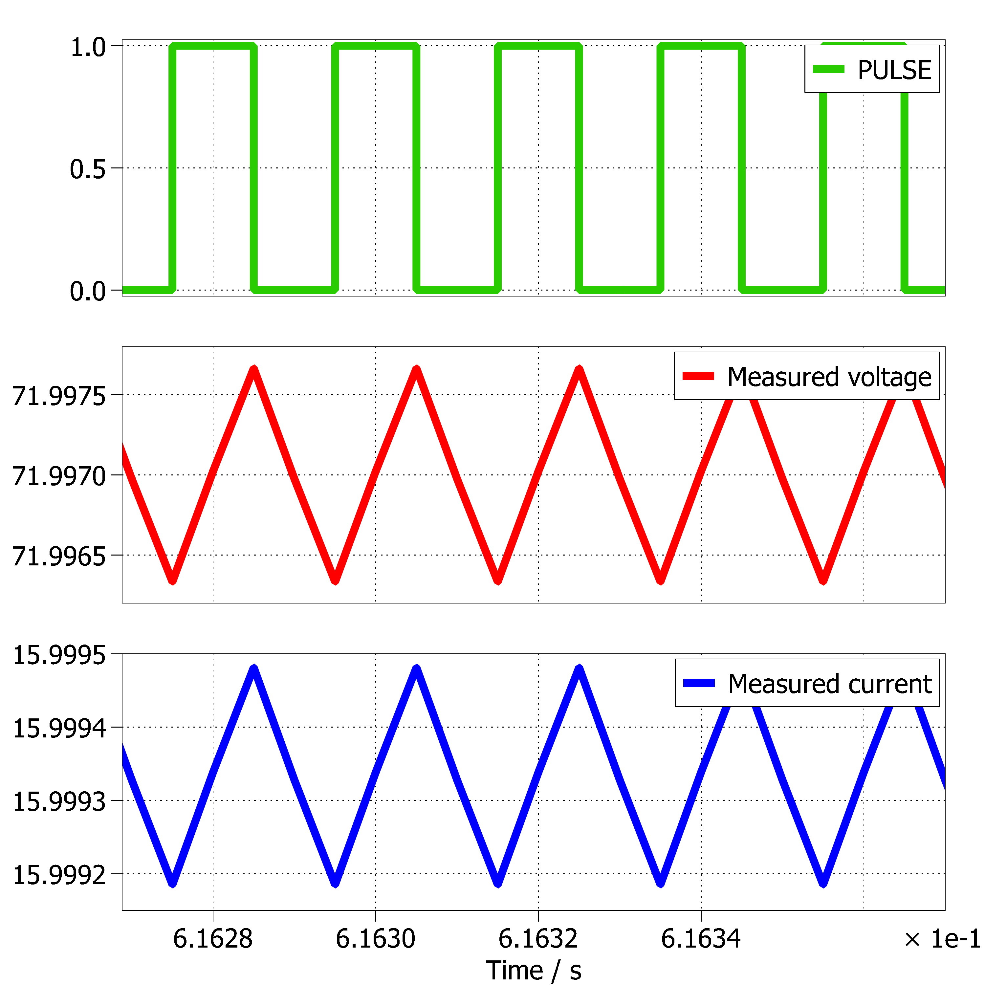
Motivation
Need for Project
Literature Review
Research Gap
Research Objectives
Proposed Converter
Analysis and Design
Simulation Result
voltage and current across Load

Slide 23
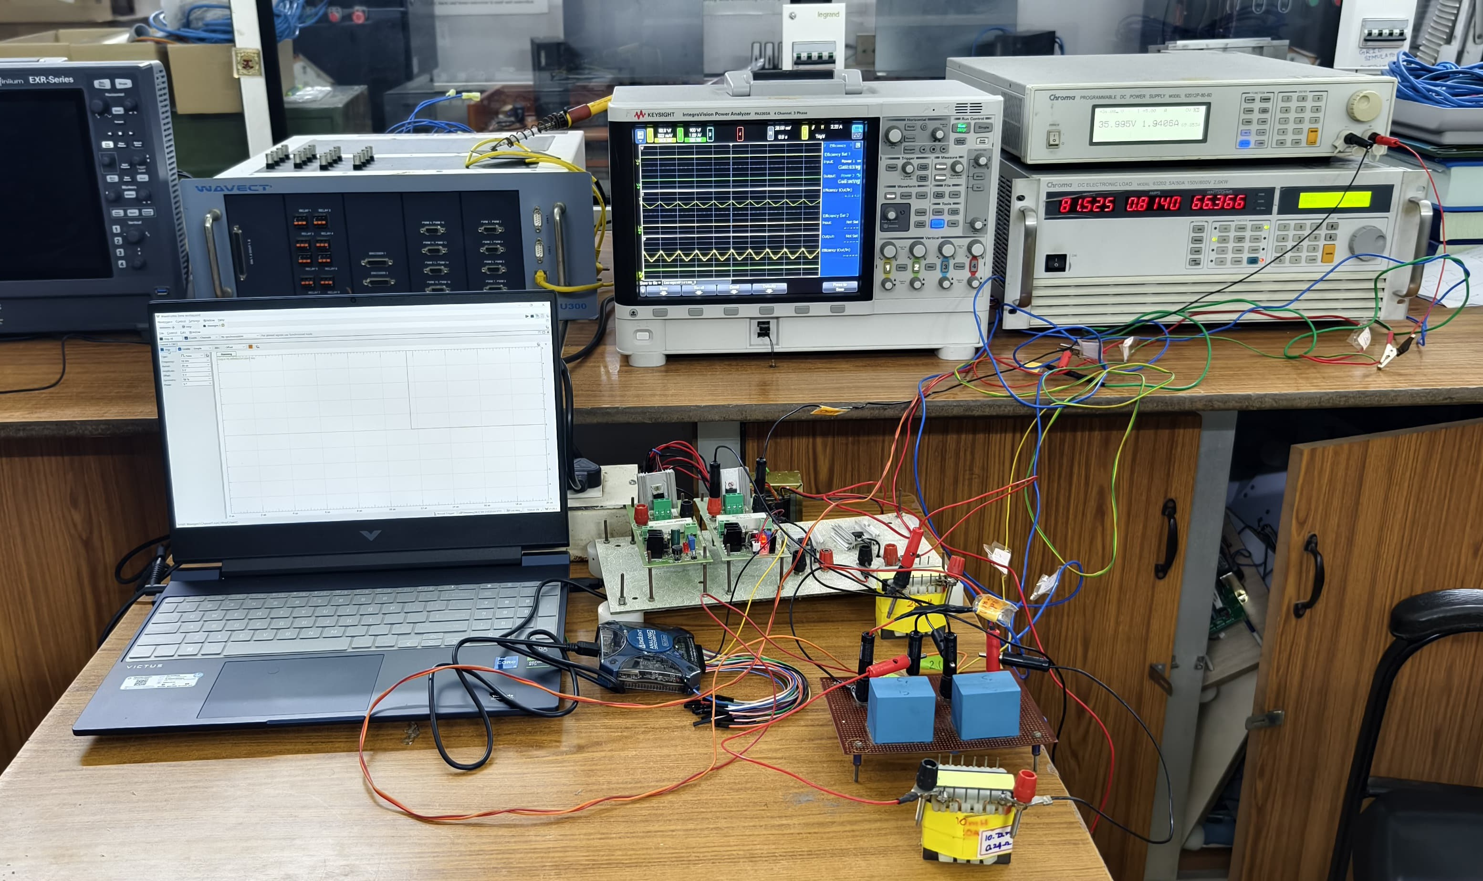
Motivation
Need for Project
Literature Review
Research Gap
Research Objectives
Proposed Converter
Analysis and Design
Hardware Setup

Slide 24
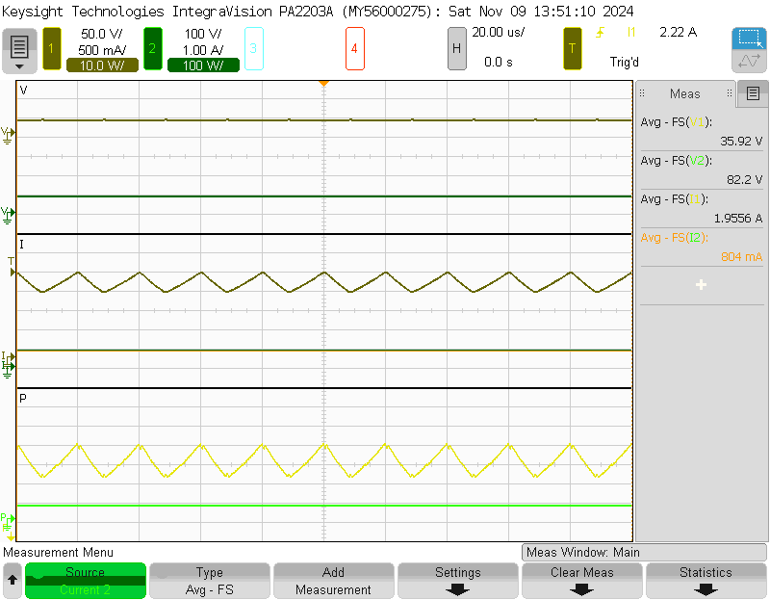
Motivation
Need for Project
Literature Review
Research Gap
Research Objectives
Proposed Converter
Analysis and Design
Hardware Results
Input Voltage
Output Voltage
Input Current
Output Current
Input Power
Output Power

Slide 25
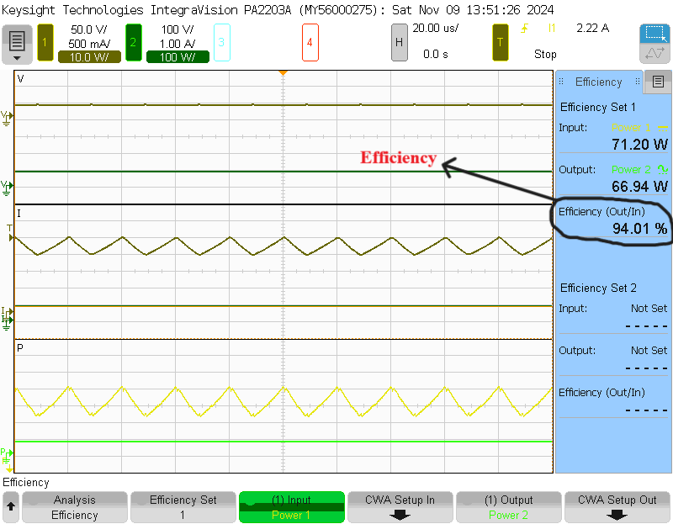
Motivation
Need for Project
Literature Review
Research Gap
Research Objectives
Proposed Converter
Analysis and Design
Hardware Results

Slide 26
Motivation
Need for Project
Literature Review
Research Gap
Research Objectives
Proposed Converter
Analysis and Design
Application
PV based system application
Electric vehicle power systems

Slide 27
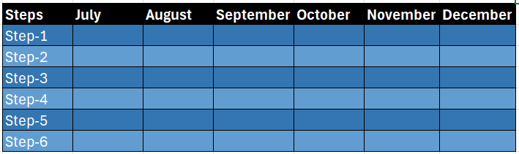
Time Line
Domain Selection
Literature Review
Simulation and debugging
Hardware Implementation
Preparation of Report

